Slide 1
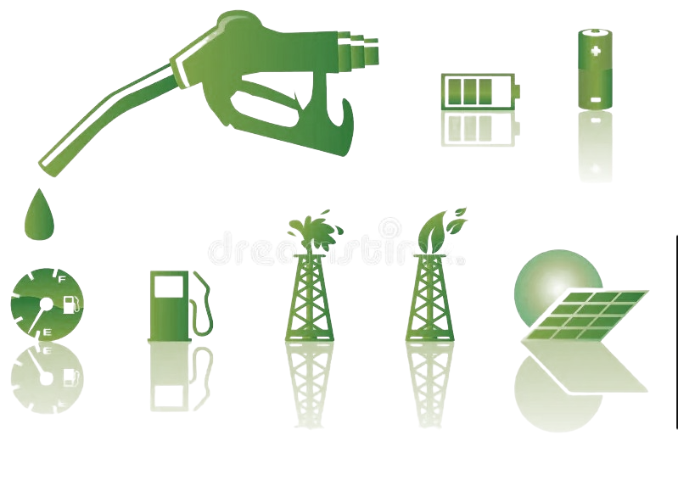
GLOBAL RENEWABLE ENERGY TRANSITION ANALYSIS AND FORECAST
SATURDAY, NOVEMBER 11, 2023

Slide 2





TEAM INSIGHT_IQ
GRACE EMERUWA
PRESENTER 1
ILIAS SHITTU-GBEKO
PRESENTER 2
TEAM LEAD
ILIAS SHITTU-GBEKO
ASSISTANT TEAM LEAD
NHISHTHA PANDEY
QUERY ANALYST
OLOLADE AYOMIDE
OTHER TEAM MEMBERS
Ikechukwu Daniel
Grace Emeruwa
Nichodemus Okenna Ugwu
Cletus Ogar
Aramide Arabesin

Slide 3
PROBLEM STATEMENT
Urgent shift from non-renewable to renewable energy is vital for sustainable infrastructure. Non-renewables harm the environment and hinder infrastructure growth. We must uncover renewable energy trends, tackle adoption barriers, and eliminate non-renewables for sustainable infrastructure and environmental health Hence, the goal of project is to:
Examine global trends in renewable energy adoption.
Identify leading countries through forecasting for global renewable energy goals.

Slide 4
OUR APPROACH
The exploratory data analysis began with univariate analysis and progressed to bivariate and multivariate analyses, including various data visualizations.
Daily granularity in energy consumption data enhances accuracy with standardized datetime columns, while statistical techniques reveal insights for informed energy sector decisions.
We enhance our time series analysis by extracting seasonality attributes, decomposing data, and exploring variable correlations for improved forecasting and insights.
Model used `auto_arima`, fine-tuned hyperparameters, and selected ARIMA (0,1,0) model with an intercept. Diagnostic plots assessed performance.
Evaluated country models using key metrics and improved accuracy by optimizing intercepts, dropping redundant columns, and reducing noise.
Forecasted energy consumption for 10 years (2020-2030) to set goals, manage expectations, and facilitate policy improvement, with visualized results aiding decision-makers.

Slide 5
DATASET DESCRIPTION
The data set was sourced from "Nature Inspired Optimization Algorithms for Renewable Energy Generation, Distribution and Management - A Comprehensive Review" (Reddy, Vamsi, Kalananda, Aala, Komanapalli, Narayana, 2021) and World Consumption Statistics webpage "" (data converted from mTOE to TWh) for consumption statistics.
Four datasets compare TWh production from various energy sources, focusing on the renewable usage of the top 20 countries, including a timeline of renewable sector progress from 1997 to 2017.
The Top 20 Countries Power Generation dataset provides national data for key renewable categories.
Two additional datasets offer global TWh figures for renewable and non-renewable sources.
The latest version introduces global consumption data at national and continental levels, offering insights into energy quantity, changes over time, and the transition to renewable energy.

Slide 6
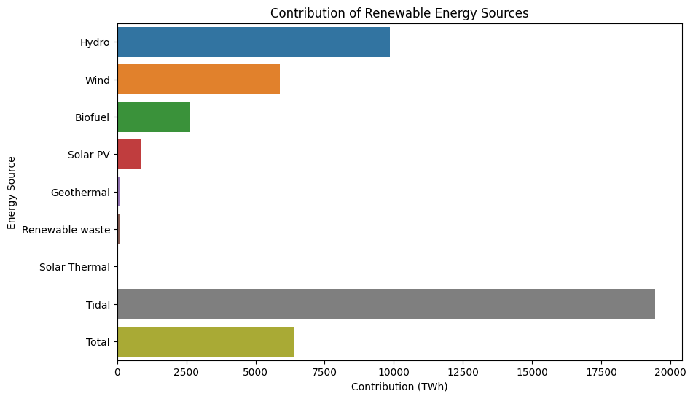
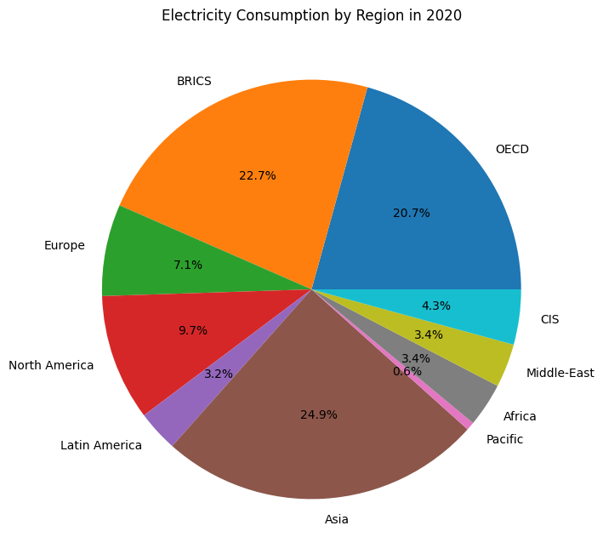
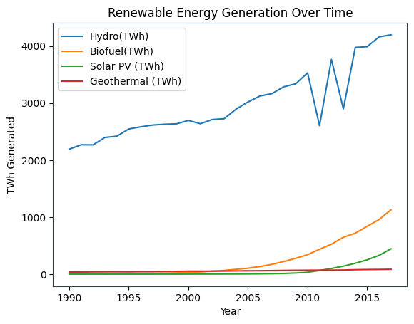
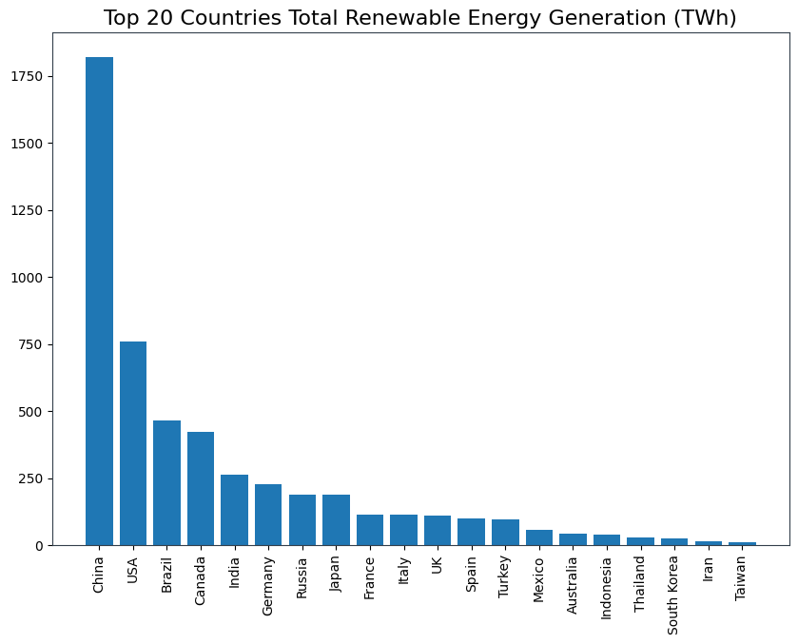
EXPLORATORY DATA ANALYSIS
The analytical visualizations cover:
Renewable Energy Contribution: Assessing the role of renewables in national energy consumption.
Regional Energy Consumption (2020): Providing regional insights into energy usage.
Renewable Energy Trends (1990-2020): Tracking the growth of renewables over time.
Top 20 Renewable Energy Nations: Highlighting leading countries in generation and adoption.
These visuals offer in-depth analysis for informed energy decisions.

Slide 7
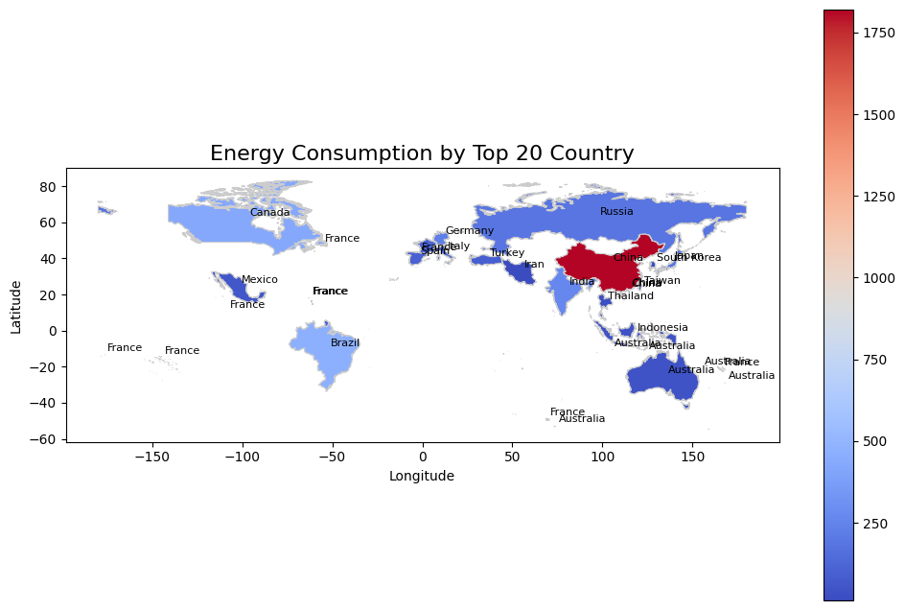
VISUALIZATION
The top 20 energy-consuming countries are responsible for over 90% of global energy consumption.
China is the world's largest energy consumer, followed by the United States and India.
Developed countries tend to have higher energy consumption per capita than developing countries.

Slide 8
DATA GRANULATION
Transitioning from yearly to daily granularity in energy consumption data is a crucial step that empowers us to capture subtle daily variations in consumption patterns. This richer dataset, with more data points, enables our predictive models to better understand daily fluctuations, leading to more accurate forecasts. We made this shift because the original dataset with only 30 rows, representing each year from 1990-2020, was too small for effective modeling.

Slide 9
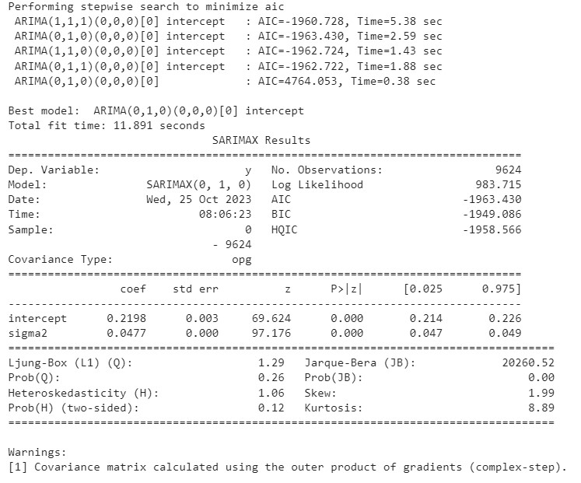
MODELING
We followed these steps to fit and train Model_1:
Started with Model_1 using `auto_arima` for time series forecasting.
Divided the dataset into training and validation sets (85:15 ratio).
Fine-tuned hyperparameters.
The model selected was ARIMA (0,1,0) (0,0,0) [0] with an intercept.
Total fit time for Model_1 was 11.891 seconds.

Slide 10
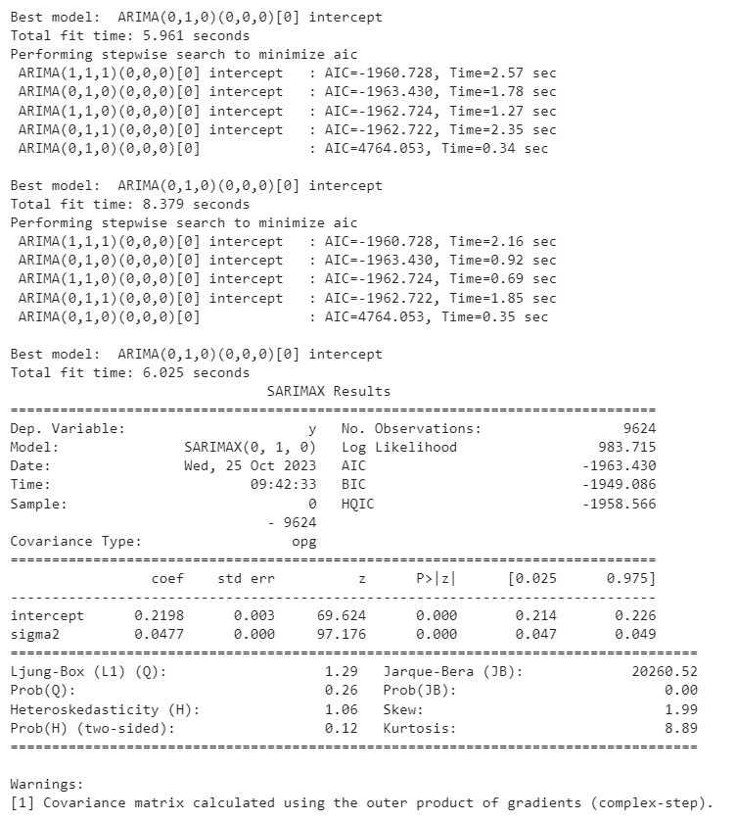
MODELING
The SARIMAX model for energy consumption in 9624 countries:
Best model: ARIMA(0,1,0)(0,0,0)[0] with intercept, AIC=-1963.430.
Explains 983.715 units of variance.
Indicates strong positive autocorrelation, no serial correlation, and non-normally distributed residuals.

Slide 11
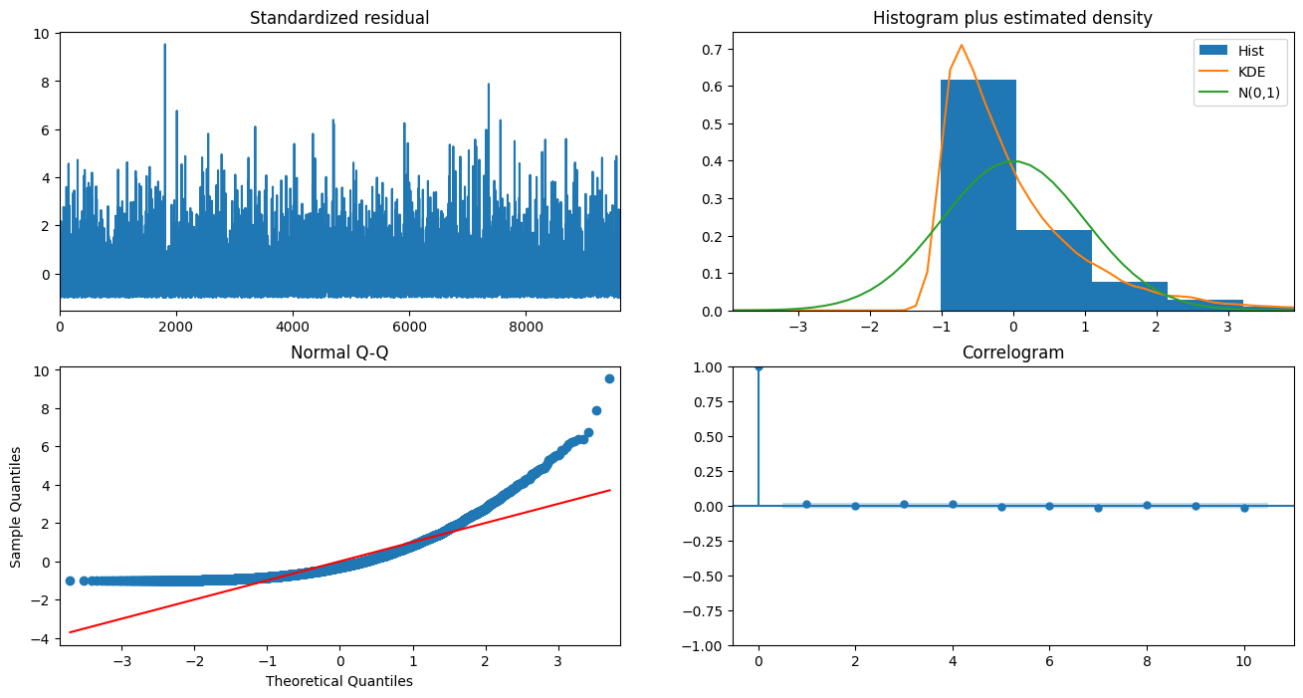
MODEL PERFORMANCE EVALUATION
Key insights from different aspects of the standardized residual data:
Histogram Analysis: Residuals show an approximately normal distribution with a slight left skew, indicating a good model fit.
Q-Q Plot Examination: Residuals align well with a normal distribution, further supporting a good model fit.
Correlogram Insights: Some residual correlation at adjacent lags, but it decays quickly, suggesting no overfitting.
Sample Quantile Assessment: Quantiles closely match the normal distribution, reinforcing the conclusion of a strong model fit.
These analyses collectively confirm the suitability of our SARIMAX model for the standardized residual data.

Slide 12
FORECASTING
Our project aims to visualize and predict energy consumption trends for each country over a 10-year period (2020-2030) for three key purposes:
1. Establishing clear energy goals in line with sustainability objectives.
2. Managing expectations and preparing for future energy needs.
3. Continuously improving energy policies and practices.
The results are presented through line plots, providing valuable insights for decision-makers in the energy sector.

Slide 13
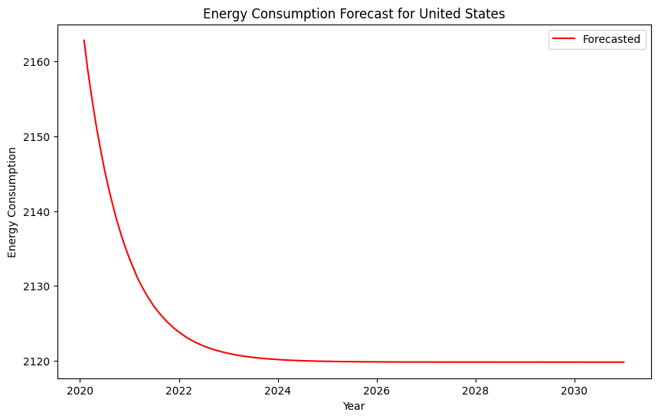
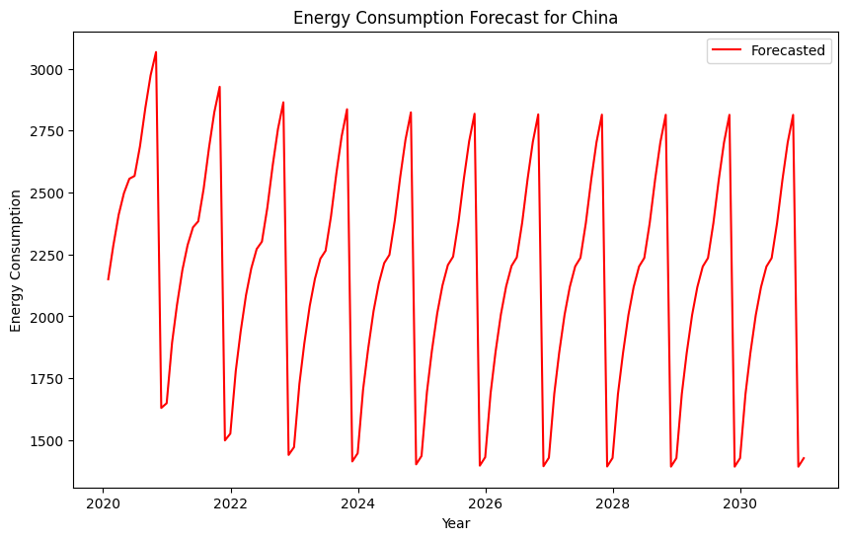
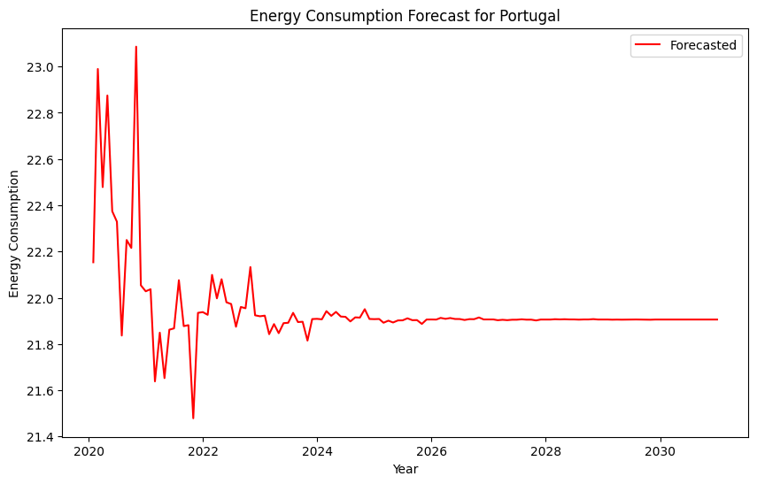
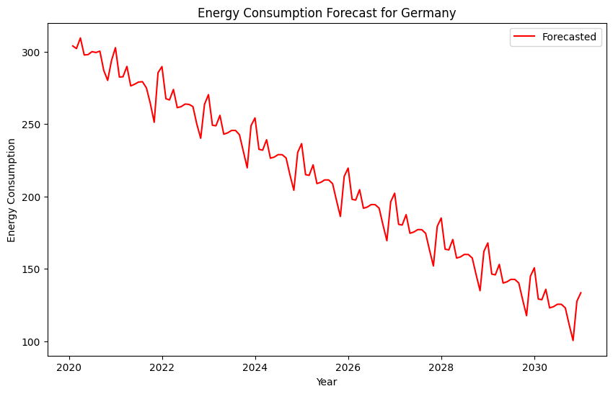
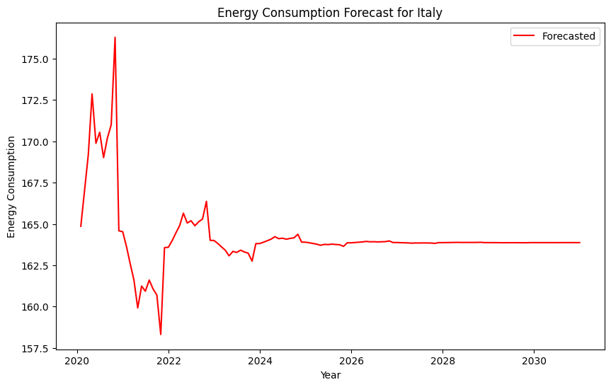
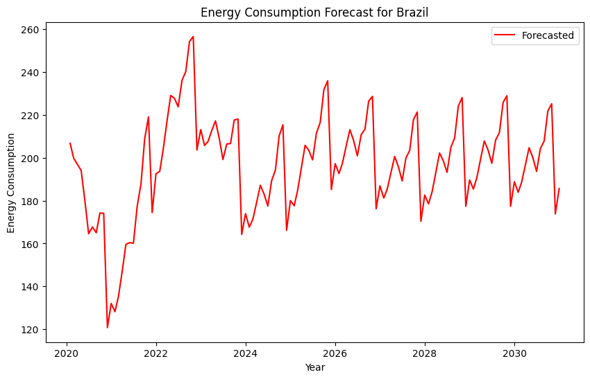
FORECASTING

Slide 14
CONCLUSION
The energy consumption forecasts for several countries, including China, Brazil, Italy, Sweden, Kazakhstan, Colombia, Japan, and Taiwan, highlight the critical challenges and opportunities they face in the coming decade. These forecasts demonstrate that economic development, population growth, and rising living standards are driving increased energy demand. However, the transition to more sustainable energy sources and enhanced energy efficiency measures is crucial to mitigate the environmental and economic impacts of rising consumption. It is evident that countries pursuing net-zero scenarios show a path towards a more secure, environmentally responsible, and economically resilient future. Monitoring progress towards these targets will be essential to ensure a sustainable energy future for these nations.

Slide 15
SUMMARY
This project is dedicated to addressing the critical nexus of energy and infrastructure, recognizing the urgent need for a transition from non-renewable to renewable energy sources. By analysing global energy data, identifying leading countries in renewable energy adoption, forecasting the path to global renewable energy goals, and pinpointing barriers to rapid adoption, it aims to provide actionable recommendations for sustainable infrastructure development. This multifaceted approach aligns with the overarching goal of creating a more resilient, environmentally responsible, and sustainable global infrastructure landscape.

Slide 16
PROJECT LINKS
The following links provide access to additional details on project, related codes and article as well as the forecasted data
Insight_IQ Premiere Project HDSC ‘23 github repo
Project Documentation Insight_IQ Premiere HDSC ’23
Project Presentation Insight _IQ Premiere HDSC ‘23

